Slide 1
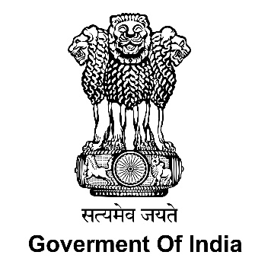

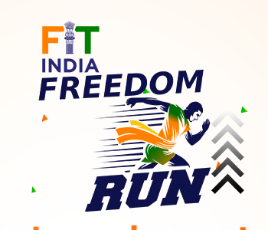

Celebrating 75 Years of India’s Independence
Azadi ka Amrit Mahotsav
FIT INDIA FREEDOM RUN 2.0
Implementing Agency:
Ministry of Youth Affairs & Sports

Slide 2
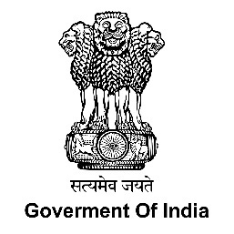


Background and Concept
Country is celebrating Azadi ka Amrit Mahotsav as a part of commemoration of its 75th years of India’s Independence.
This is to celebrate and commemorate 75 years of progressive India and its glorious history, culture and achievements.
Hon'ble Prime Minister while inaugurating the curtain raiser of Azadi ka Amrit Mahotsav on 12th March 2021, said that “The celebrations can be divided in five sub-heads - Freedom struggle, Ideas at 75, Achievements at 75, Actions at 75, and Resolve at 75.”
Deptt. Of Youth Affairs( with NYKS and NSS Volunteers) have conceptualized celebration of Azadi ka Amrit Mahotsav under the pillar of Actions and Resolves @75.
Spirit of Programmes/Activities : Jan Bhagidari and Jan Andolan
Focus is on low-cost and people-intensive activities and to encourage community participation.

Slide 3


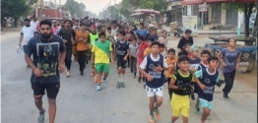
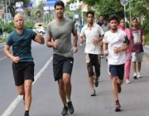
Fit India Freedom Run
(13th August 2021 to 2nd October 2021)
Theme: Jan Bhagidari to Jan Andolan
Launch: 13th August 2021 by Hon’ble Minister of Youth Affairs & Sports, Sh. Anurag Singh Thakur and Hon’ble Minister of State, Youth Affairs & Sports, Sh. Nisith Pramanik
Objective
To encourage people to take up fitness activities such as running and sports in their daily lives.
To make people adopt healthy and fit life style.
Geographical Coverage:
All States and UTs
750 Districts: 750 Districts divided into 10 segments of 75 Districts each. 75 Villages in each District
30,000 Educational Institutions
Participation Target:
42.18 Lakhs Youth Volunteers will directly participate. (750 Districts *75 Villages *75 Youth)
Each youth will be motivated to include 20 family members & Peer Group , getting outreach of 7.50 Cr people.

Slide 4
Key Activities:
Pledge on Fit India Freedom Run
National Anthem; Rendering of National Anthem on https://rashtragaan.in
Fit India Freedom Run; Run/ Visit around historical, iconic places and other important locations of significance.
To register and upload run on Fit India portal https://fitindia.gov.in and promote freedom run on social media channels with #Run4India and #AzadikaAmritMahotsav.
Cultural Functions at starting point or finishing line, highlighting the importance of Azadi Ka Amrit Mohatsav.
Awareness among Youth Volunteers and Youth Leaders to participate in the Run and also organize similar Freedom Run in their respective villages on their own.
Youth Volunteers and others to carry placards, banners etc.

Slide 5
Media and Publicity:
Pre-programme Buzz: Massive Buzz creation for #Run4India #AzadiKaAmritMahotsav through;
Jingles
FM/RJs
Village Radio
News Scroll
Display of Logos, banners, IEC
Massive Twitter Trends;
Tweets by each NYKS twitter handler
Social Influencers
Cross tagging
Professional help
Post-programme Publicity: Video by participating youth about their experiences-sharing on Twitter and trends generation.
Demo Video
Target- 75*75= 5625 small videos on each date
56,250 (750*75) videos during whole programme

Slide 6

Before & After the programmes;
In each district NYK would release Press Notes to Electronic & Print Media
local and Regional Media
(T-Shirts to be provided to Media Persons)
Collection and sharing of Inspirational Videos Messages;
By celebrities, social influencer, persons of eminence on social media platforms
Uploading of video on their Handles and tagging with MYaS Handles
Extended Participation in the run (Specific Run)
Public Representatives
PRI leaders
Social Workers,
Media Personalities,
Sportspersons.
Army personnel

Slide 7
Collaboration with
Information & Broadcasting Ministry
Ministry of Culture
Fit India
SAI
CAPFs
Civil Services
Armed Forces
Impact Assessment:
Number of Public Representatives and National Figures participated.
Level of coverage in print, electronic and social media (Number of Tweets, likes, shares, impressions, engagements).
No. of Videos uploaded on programme.
Total number of participants and Kilometers covered.

Slide 8
THANK YOU

